Slide 1
Capstone Project – 1
Goodreads Book Recommendation System
Submitted by : Anshul Vyas
Mentor : Kevin Glynn

Slide 2
Contents
Overview
Analysis
Data Exploration
Exploratory visualization
Methodology
Results

Slide 3

Overview
We are living in an era of the digital world. People are communicating and spending most of their time on social media
Lots of digital content is available in the form of eBooks / audio books on the internet.
Goodreads is one of the social platform where people can vote , write a summary to various books.
There is a requirement of a system which can recommend the similar books to a user

Slide 4
Data Source
Goodreads 10k books data is available on Kaggle website.
Dataset can be downloaded from the following link:
https://www.kaggle.com/zygmunt/goodbooks-10k

Slide 5
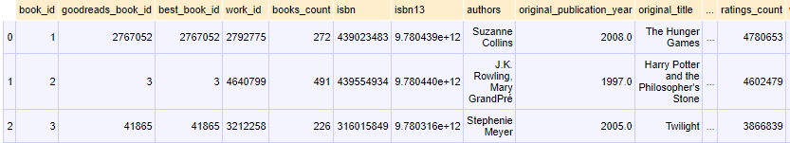
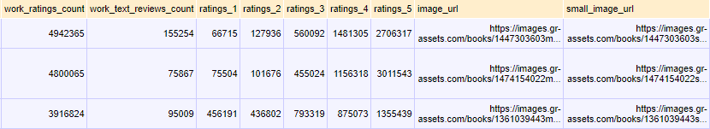
Data Exploration
The dataset has total 10000 entries in main book dataset
Following tables shows the basic nature of the dataset:

Slide 6


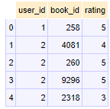
Exploratory visualization
Book_tag information
Tag information
Rating information

Slide 7
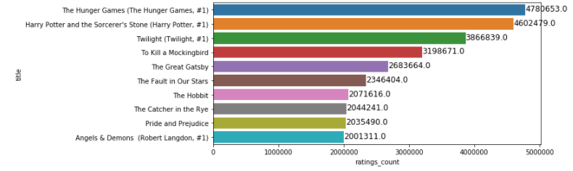
Exploratory visualization
Various insights from the datasets:
(Top 10 rated books on the basis of frequency of votes)

Slide 8
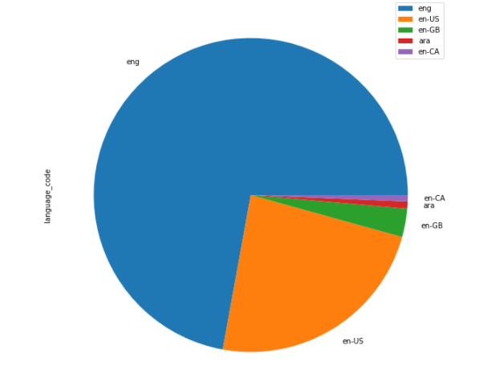
Exploratory visualization
Language distribution over 10k books:

Slide 9
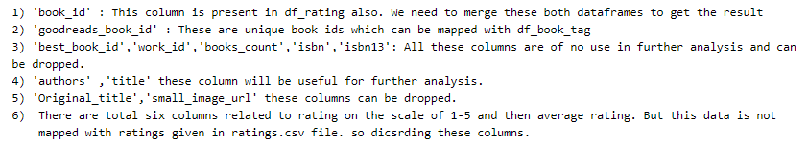
Insights from Dataframes

Slide 10
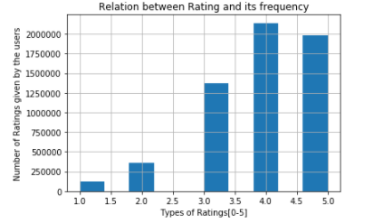
Exploratory visualization
Relation between Rating and frequency

Slide 11
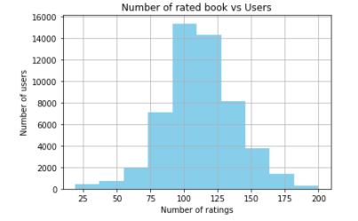
Exploratory visualization
Books vs Users

Slide 12
Exploratory visualization
Relation between Rating and frequency

Slide 13
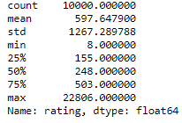
Statistical overview
Book dataset

Slide 14
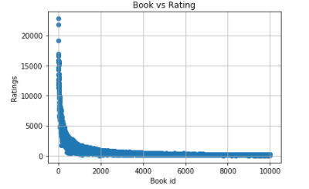
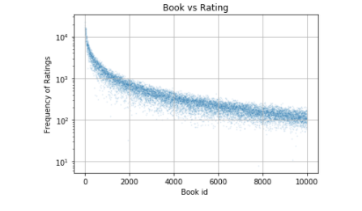
Data Visualization
Book vs Rating (Skewed plot)
Book vs Rating (on a log scale)

Slide 15
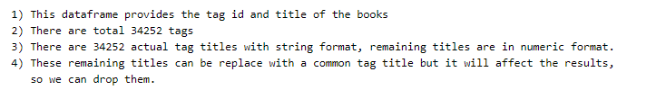
Insights from Dataframe

Slide 16
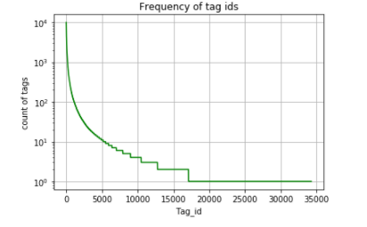
Data Visualization
Frequency of tags:

Slide 17
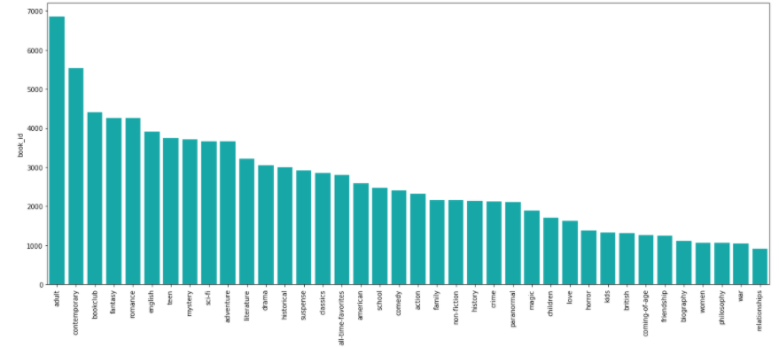
Data Visualization
Types of genres:

Slide 18
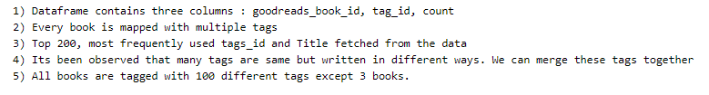
Insight from Dataframe

Slide 19
Methodology
1) Top – N Recommended
2) Content Based Recommendation System

Slide 20
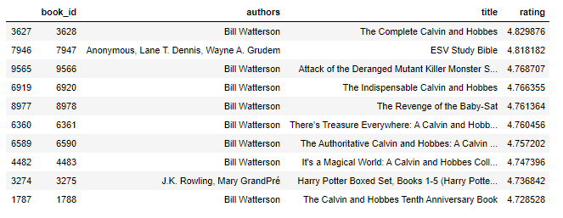
Top-N Recommendation
Following is the list of top rated 10 books:
Clearly, above result is not efficient. it is just a list of top 10 books which were rated well.

Slide 21
Content based
Data reformation steps
Book data frame merged with tags data frame
Resulted data frame merged with rating data frame
All different types of tags merged in a single cell
Author name formatted and mixed with the tag cell
Idea behind this data rearrangement was to get the all possible information at one place so that content based methods can be applied.

Slide 22
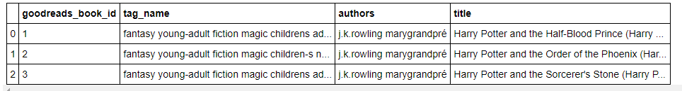
Formatted Dataframe
Final data frame :

Slide 23
Methodology
Count-vectorizer were used so that each and every word can be taken care of
A matric generated on the basis of Cosine similarity concept

Slide 24
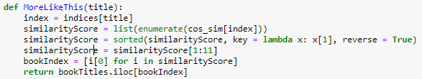
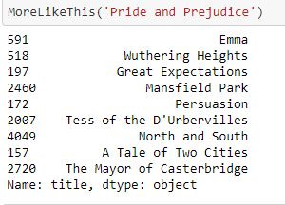
Methodology and Result
Method
Result

